Slide 1


EDUrURAL-aI: Ai driven learning for rural Education
Submission by : GC3
Sharath - 4SO22CS142
Vishwas P G - 4SO22CS184
Krishna Mohana.K - 4SO23CS405
Nithin Kumar - 4SO23CS406
Under the Guidance of
Ms Pruthvi M R
Assistant Professor, Department of CSE

Slide 2
Introduction
In many rural areas, students face significant barriers to accessing quality education due to limited infrastructure, lack of trained teachers, and language constraints. This project aims to leverage artificial intelligence to create a personalized tutor that provides inter active learning experiences. The system will support text-based interactions, adaptive learning paths, and offline functionality, ensuring students can continue learning even without stable internet access

Slide 3

Objectives
To develop an AI/ML model that efficiently analyzes and learns from large datasets
Develop an AI-powered tutor that offers personalized learning experiences.
Integrate real-time doubt resolution through AI-driven chatbot assistance.
Ensure offline access through local data storage and periodic cloud synchronization.

Slide 4
Applications
Rural Education: Provides AI-powered, personalized learning in remote areas with offline support.
Vocational Training : Enables self-paced skill development for adults and rural workers.
Disaster & Conflict Zones: Ensures uninterrupted education in areas with school closures.
Government & NGO Programs: Supports literacy and educational outreach initiatives.
Corporate Training: Facilitates remote workforce upskilling with AI-driven learning.

Slide 5
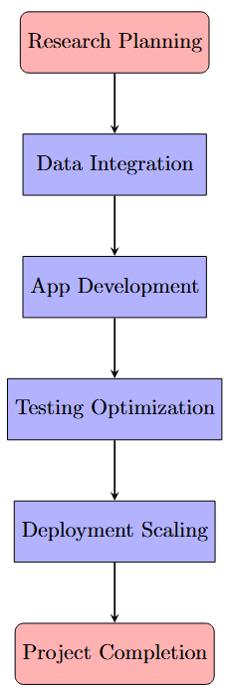
methodology
Research & Planning : Focused on rural students' needs and selected educational content from NDLI (textbooks, videos, articles) aligned with school curricula.
Data Integration : Integrated NDLI API to fetch relevant educational resources. Developed offline access using SQLite to store content locally.
App Development : Built a Flutter mobile app with a split layout: topic categories on one side and a chatbot on the other for student queries . Integrated an AI chatbot powered by NLP models (GPT-3/BERT) to answer educational questions.
Testing & Optimization : Conducted field testing in rural schools, gathered feedback, and optimized the app for low-power devices and offline functionality.
Deployment & Scaling : Deployed the app on Google Play Store and scaled it through collaborations with schools and NGOs

Slide 6
software & hardware requirement
Software Requirements :
Programming Languages: Python (ML), JavaScript (Frontend), Dart (Flutter)
Frameworks: Flask/Django (Backend), TensorFlow Lite (AI models)
Database: SQLite (Offline), Firebase (Cloud Sync)
Tools: Android Studio, Visual Studio Code, Git
Hardware Requirements:
Computer with minimum 8GB RAM (16GB recommended for smooth development)
Multi-core processor (Intel i5 or equivalent, or higher)
Minimum 256GB SSD for faster data processing and application performance
Stable internet connection for database management, and accessing online resources

Slide 7
Final Outcome
Students will have access to a personalized AI tutor that helps them learn at their own pace.
The mobile app will be easy to use, making learning more accessible.
Students will receive instant feedback and progress tracking to improve their learning.
Learning will be available offline, ensuring uninterrupted education

Slide 8
references
[1] A. Kumar, S. Patel, and R. Singh, “Mindcraft: Revolutionizing Education through AI-Powered Personalized Learning and Mentorship for Rural India,” arXiv preprint arXiv:2502.05826, 2024.
[2] S. Kumar and D. Patel, “Offline-First AI Education: Bridging the Digital Divide in Rural Areas,” in 2023 International Conference on Educational Technology. IEEE, 2023, pp. 78–85.
[3] W. Cao, Y. Liu, and L. Zhang, “AI-Tutor: Solution for China’s Disadvantaged and Rural Areas,” International Journal of Educational Technology in Higher Education, vol. 21, no. 1, pp. 1–18, 2024.

Slide 9
Thank you!

